Slide 1

Reverse Engineering
Mohammad Reza Barazesh
91521059
IUST

Slide 2
Part I : Introduction

Slide 3
What is reverse engineering ?
Reverse engineering is the process of discovering the technological principles of a device, object, or system through analysis of its structure, function, and operation. It often involves disassembling something (a mechanical device, electronic component, computer program, or biological, chemical, or organic matter) and analyzing its components and workings in detail - for either purposes of maintenance or to support creation of a new device or program that does the same thing, without using or simply duplicating (without understanding) the original.

Slide 4
Reasons for reverse engineering :
Reverse-engineering is used for many purposes: as a learning tool; as a way to make new, compatible products that are cheaper than what's currently on the market; for making software interoperate more effectively or to bridge data between different operating systems or databases; and to uncover the undocumented features of commercial products.

Slide 5
Reverse engineering tools
Debuggers
Disassemblers and decompilers
PE info viewers
Resource editors
Memory editors
Hex editors
Unpackers

Slide 6
What Is a debugger?
A debugger or debugging tool is a computer program that is used to test and debug other programs (the "target" program).
We can monitor a program parts in real time using a debugger ,
Such as registers , memory , current codes getting executed , memory segments , and more ...
Debuggers mostly use a disassembler.
Some famous debuggers are : Ollydbg – windbg – IDA Pro – visual studio debugger – GDB - …

Slide 7
What is a disassembler & a decompiler ?
A disassembler is a computer program that translates machine language into assembly language—the inverse operation to that of an assembler. A disassembler differs from a decompiler, which targets a high-level language rather than an assembly language. Disassembly, the output of a disassembler, is often formatted for human-readability rather than suitability for input to an assembler, making it principally a reverse-engineering tool.
This is done simply by translating the hex value of the OPcodes to their mnemonics .

Slide 8
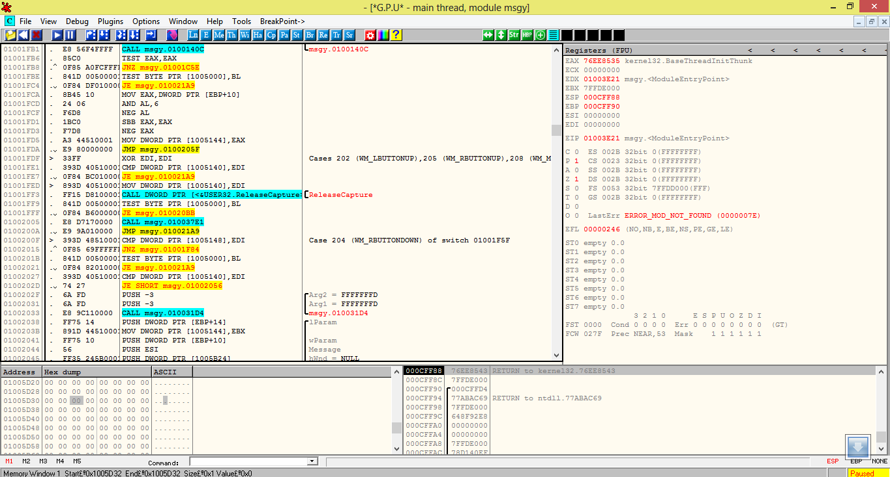
A view of ollydbg , attached to minesweeper

Slide 9
What is PE?
The Portable Executable (PE) format is a file format for executables, object code, DLLs, FON Font files and others used in 32-bit and 64-bit versions of Windows operating systems. The PE format is a data structure that encapsulates the information necessary for the Windows OS loader to manage the wrapped executable code. This includes dynamic library references for linking, API export and import tables, resource management data & etc .
A PE file consists of a number of headers and sections that tell the dynamic linker how to map the file into memory. An executable image consists of several different regions, each of which require different memory protection; so the start of each section must be aligned to a page boundary. For instance, typically the .text section (which holds program code) is mapped as execute/read only, and the .data section (holding global variables) is mapped as no-execute/read write.

Slide 10
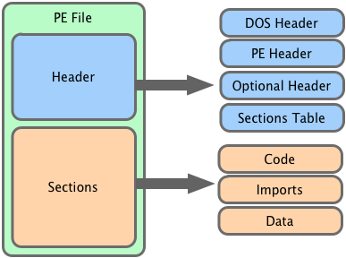
What is a PE viewer ?
Pe viewer is a program used to analyses important data about a PE file
Such as starting point , import tables , resources , and etc …

Slide 11
A program memory structure
Data segment
Stack
Code segment
Data segment
Data
BSS
Heap

Slide 12
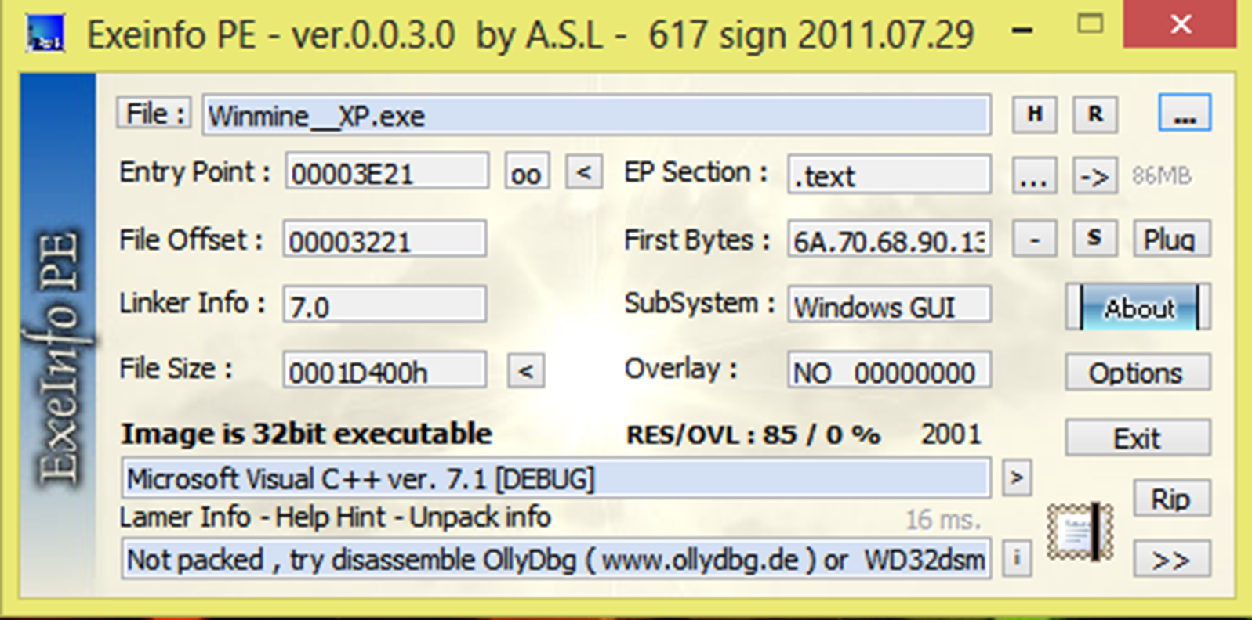
Exe info – A PE viewer

Slide 13
What is a resource editor ?
A program to edit and view a PE file resource files
A PE resources are : bmp , WAV, dialog data , strings , etc …
We can change the program language easily using a resource editor .
Some resource editors are : resource hacker , PE editor , PE explorer …

Slide 14
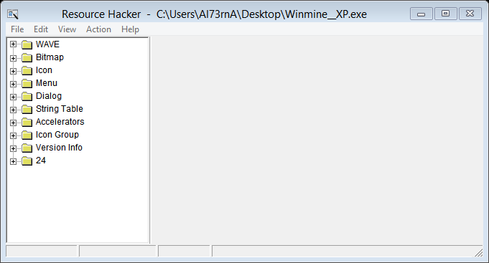
Resource Hacker

Slide 15
What is a memory editor ?
Memory editor is a program which scans and edits the variables located in the data segment of a program. This includes both the heap and Data.
A memory editor first search for a variable in memory . We can later change the variable in program and filter the found variables until we are sure we have found the right address for our variable .
This is very useful since there might be hundreds of thousend of addresses containing the value we are looking for at the first look . While in fact only a few are the correct ones . ( most of the times below 10 addresses)

Slide 16
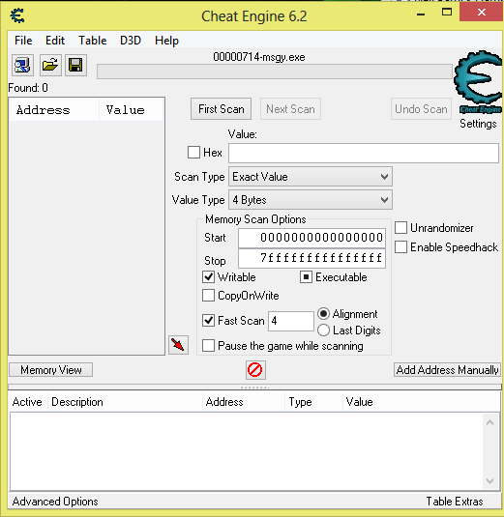
CE , A memory Editor

Slide 17
What is a hex editor ?
A hex editor (or binary file editor or byte editor) is a type of computer program that allows for manipulation of the fundamental binary data that constitutes a computer file.
With a hex editor, a user can see or edit the raw and exact contents of a file.

Slide 18
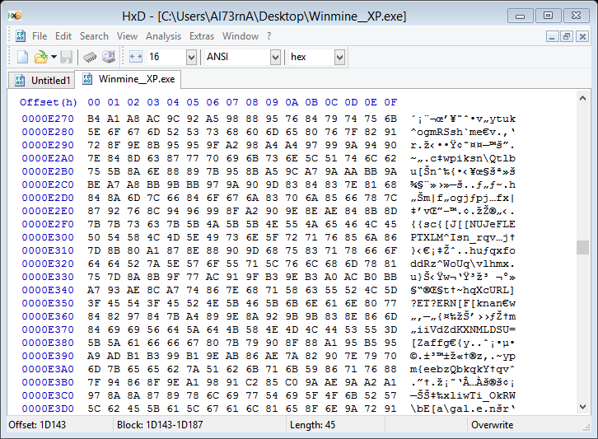
HxD , A Hex Editor

Slide 19
What is Packing and an unpacker ?
Software distributors use executable compression for a variety of reasons, primarily to reduce the secondary storage requirements of their software; as executable compressors are specifically designed to compress executable code, they often achieve better compression ratio than standard data compression facilities such as gzip, zip or bzip2[citation needed]. This allows software distributors to stay within the constraints of their chosen distribution media (such as CD-ROM, DVD-ROM, or Floppy disk), or to reduce the time and bandwidth customers require to access software distributed via the Internet.
Executable compression is also frequently used to deter reverse engineering or to obfuscate the contents of the executable (for example, to hide the presence of malware from antivirus scanners) by proprietary methods of compression and/or added encryption. Executable compression can be used to prevent direct disassembly, mask string literals and modify signatures. Although this does not eliminate the chance of reverse engineering, it can make the process more costly.

Slide 20
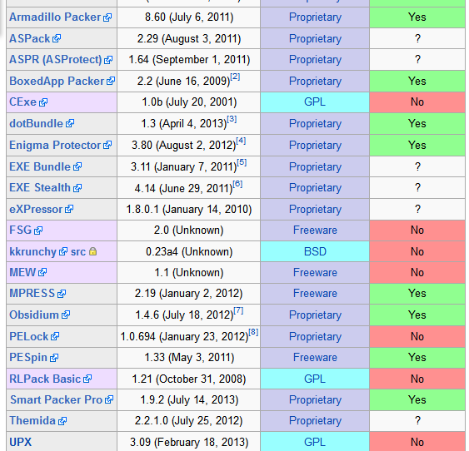
List of common packers

Slide 21

Part II : Reversing Mine Sweeper

Slide 22
Map of the road
Analyzing the program
Finding the events
Analyzing the code
Writing new codes
Changinge resource files
Finding the variables adresses

Slide 23
First analyze of the program
First we can take a look at a program header and guess which programming language it has been written with , and whether it has been packed with any packer or not .
We can use a hex editor to do this if we know which header we are looking for . Or we can programs with built in header templates for this job .

Slide 24
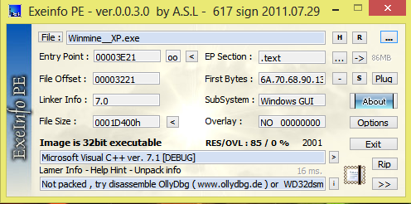
Program analysis with Exeinfo

Slide 25
Finding the addresses of variables
We need to use a memory editor for this section
A hex editor can be used as well , though it well make the job a lot harder
Some memory editors are : Tsearch – CE – Conqueror – MHS - …
We need to search for all the variables in the program with our current value . Then change our value and filter all the result to the new value .
This can also be done in any programming language , we need to dump the memory and keep filtering variables .

Slide 26
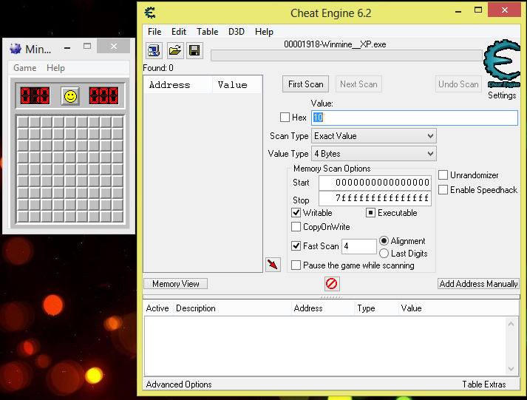

Slide 27
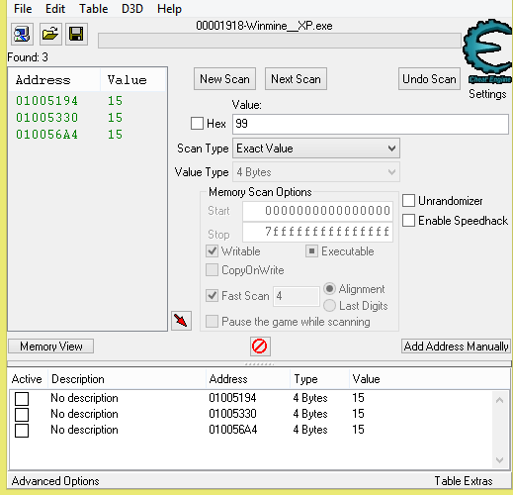

Slide 28
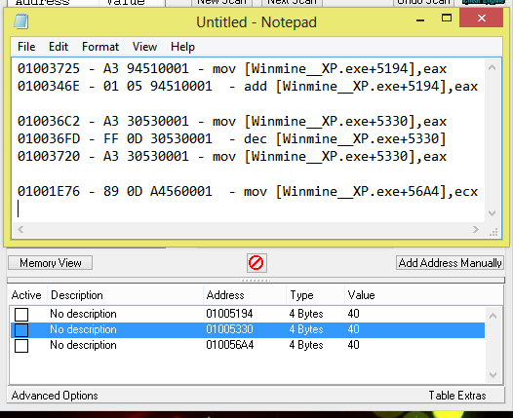

Slide 29
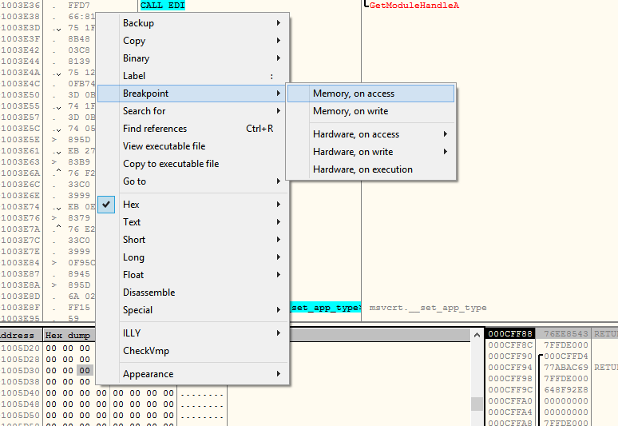
Alternative way to find what address writes to certain memory address using ollydbg :

Slide 30
Analyzing the code
We have found the addresses in which an instruction writes to our specific memory addresses .
Now we know where to look in our disassembled source

Slide 31
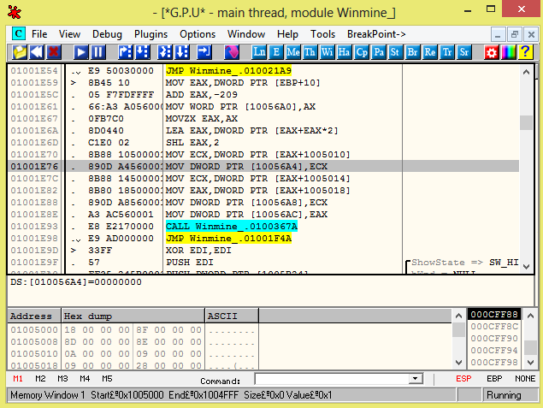
The Adress we found earlier

Slide 32
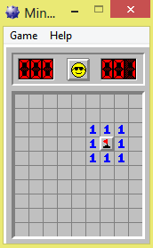
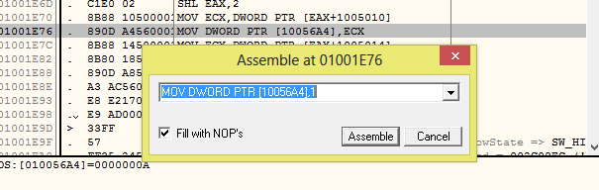
ReAssembling the address so we always have 1 mine …

Slide 33
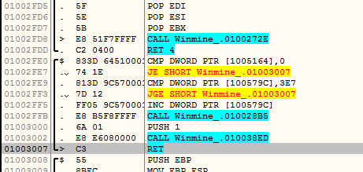
Now lets look into something else … the timer
The address of the timer is Winmine__XP.exe+579C
The following line writes to this address :
01002FF5 - FF 05 9C570001 - inc [Winmine__XP.exe+579C]

Slide 34
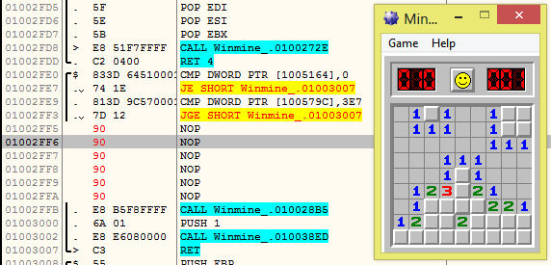
Reassembling the code …
We can change the “inc” to “dec” so the timer goes backward
Or we can replace it with “nop” so the timer doesn’t move at all …

Slide 35
Now lets add a message box to the game !
we now know an address which is executed everytime the counter ticks !
We cannot simply add something inbetween the codes , so we need to set a detour .
lets find some empty space in the code segment of memory …

Slide 36
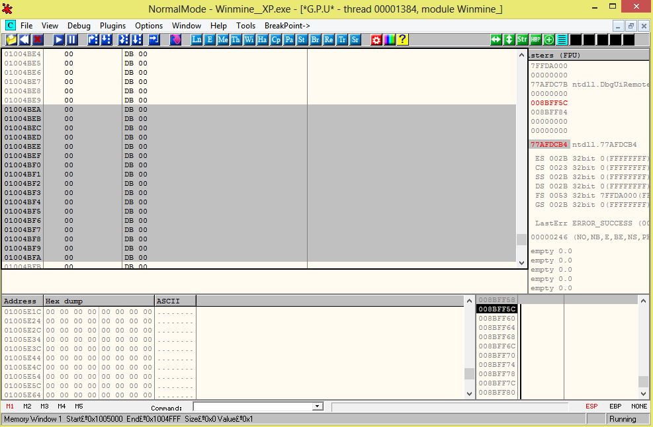
Here is an unused space in memory . we will use this as a code cave .

Slide 37
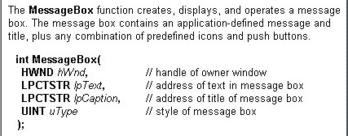
MessageBoxA

Slide 38
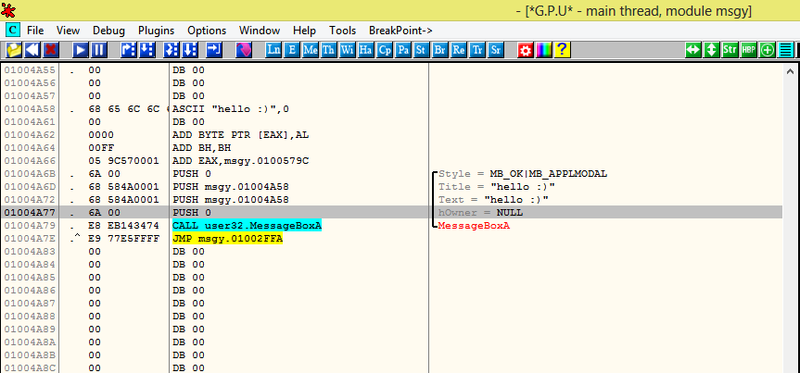
Time to write the code cave (in data segment)

Slide 39
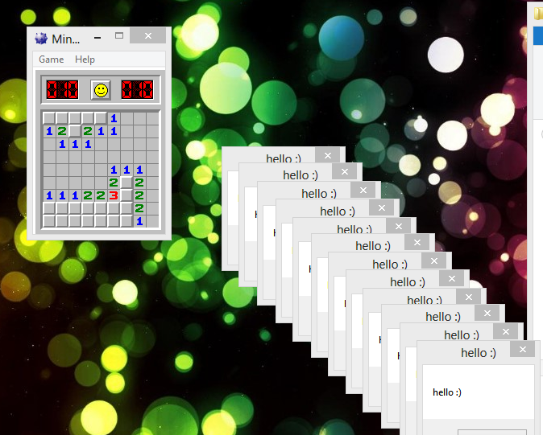
Our changed program in action

Slide 40
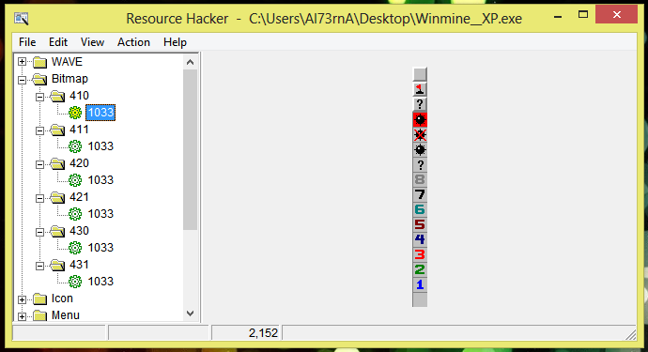
First view of program using a resource hacker

Slide 41
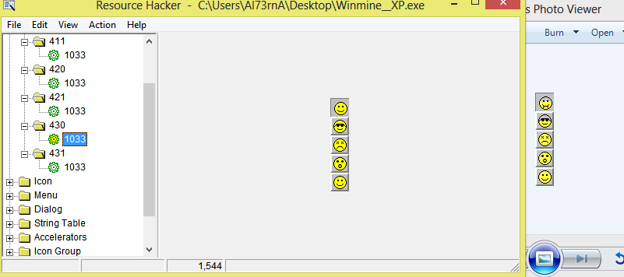

Slide 42
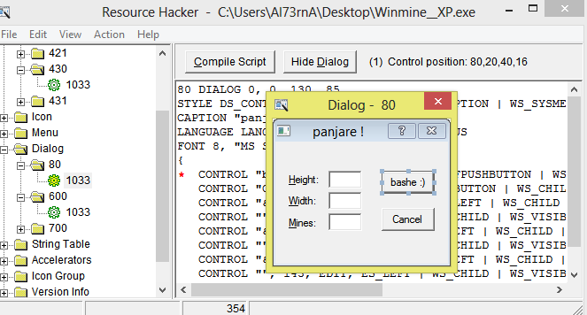

Slide 43
Changing an static in-game value
Minesweeper has the cheat “XYZYYZ” which can reveal mines.
Lets change it to “BRZBRZ” !
We will use a text finder , then use a hexeditor to permenantly change this string to our desired one

Slide 44
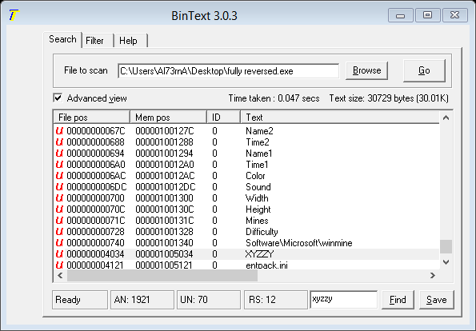
Using a string search to find the Unicode string

Slide 45
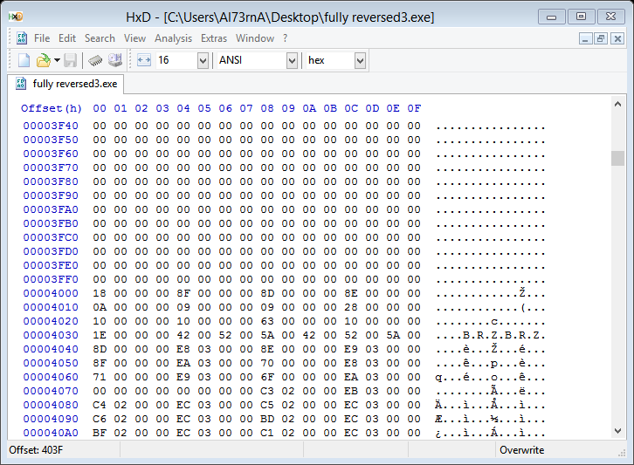
Changing the Unicode string using HxD

Slide 46
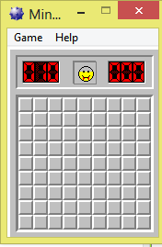
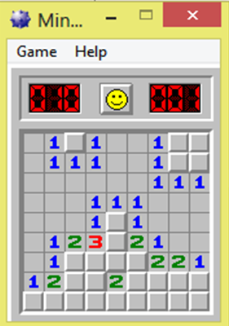
The end

